Slide 1
Movie Review Aggregation Application Using Web Scraping and Image Processing
FlickRank
Student:
Supervisor:
Paul Tudor LINCA
Assist. Prof. Dr. Eng. Ion GIOSAN
Notes:
Hello, my name is Paul Linca and under the supervision of Professor Ion Giosan I developed a movie review aggregator that uses web scraping and image processing

Slide 2

The Film Industry (2018)
1.3 billion tickets sold (US)
80.8 million Netflix subscribers (Global)
136 billion dollars (Global)
Notes:
I want to start my presentation with some statistics about the film industry as of 2018.
There were 1.3 billion tickets sold in the US alone
80.8 million Netflix subscribers worldwide
And overall, the industry was worth about 136 billion dollars

Slide 3
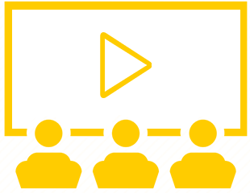
Background
Movie watching is one of the most popular pastimes of our generation.
The process of deciding what movie to watch is often unpleasant and time consuming.
A movie’s reviews are one of the leading factors that influence one’s likelihood to watch that movie or not.
Notes:
Thus, we can deduce that movie watching has become one of the most popular leisure activities.
That being said, the process of deciding if a movie is suitable to watch is often dreaded by most people, as it can become long and unpleasant.
In order to ease this, people often look up reviews of movies to see other people’s opinions on it. Reviews have become a deciding factor that influence people’s likelihood to watch a movie or not.

Slide 4

Problem
Lengthy movie choosing process.
Large amount of movie review websites.
Notes:
The problems that my project tackles are:
The lengthy process of choosing a movie
And the large amount of existing movie review websites, making finding the best reviews more difficult

Slide 5




Solution
A platform that makes finding information about movies:
Quick
Convenient
Simple
Notes:
The solution I propose is a platform that makes finding reviews and information about movies:
Quick
Simple
And Convenient
To achieve that, the platform has to be accessible and ready for use at any moment by anyone

Slide 6

Objective
Build an mobile application that provides its users:
A way to search for any movie:
manually - type its title
image search - take a picture of its poster
Movie reviews gathered from numerous sources
Relevant movie recommendations
Notes:
Thus, the objective of the project is to build a mobile application that provides its user a way to:
Search for any movie, either by typing the movie’s title or by taking a photo of the movie’s poster
Also provides movie reviews gathered from various sources
And relevant movie recommendations

Slide 7
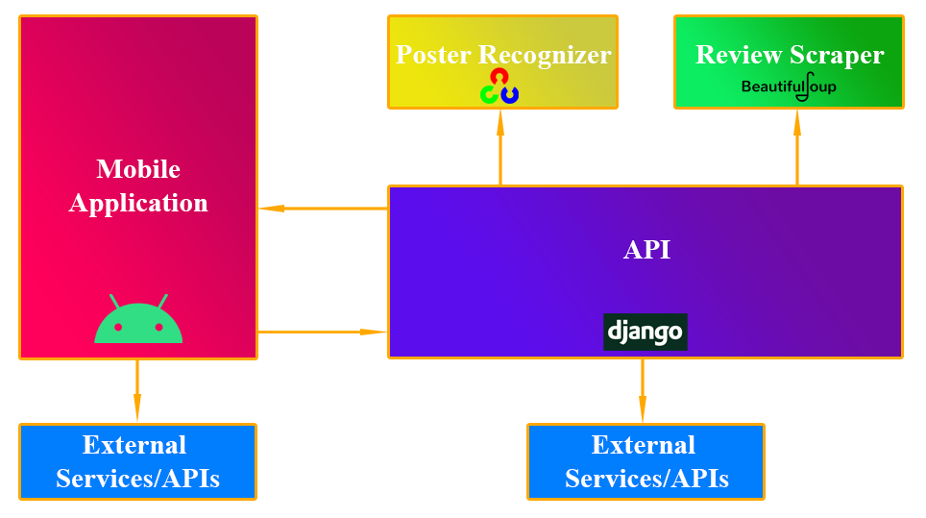
Overall System
Notes:
The system will be broken down into modules.
A mobile provides the user interface and will handle all user interaction.
It makes use of external services and APIs for authentication and movie representation
An API deployed on Heroku exposes the functionalities of a poster recognition system, a review web scraper and other systems.
The two main components communicate through HTTP requests.

Slide 8

Approach - Poster Recognizer
Library: OpenCV
Language: Python
Approach:
detect the poster from the user submitted photo and extract it
compare the extracted poster to a collection of existing movie posters and find the best match
Notes:
First, the poster recognition system.
The library I chose to perform this was OpenCV and I decided to use its Python variant.
This module consists of two parts:
First, we need to detect the actual poster from the photo received from the user and extract it
And second, we need to compare the extracted poster to existing posters and find the best match, which will represent the movie we are looking for

Slide 9

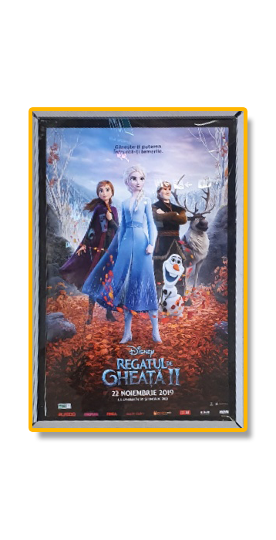
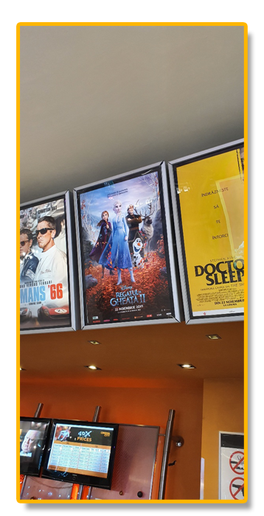
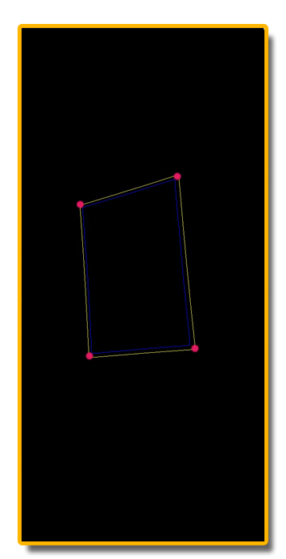
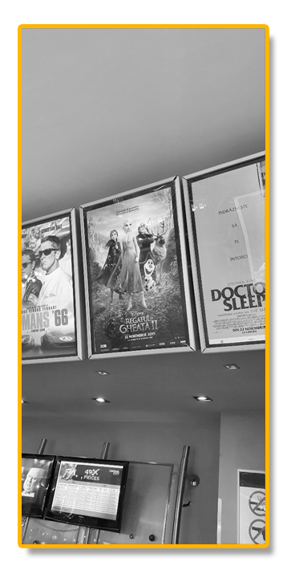
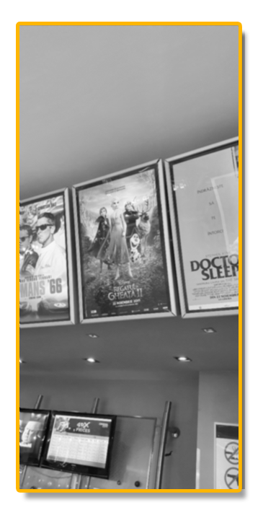
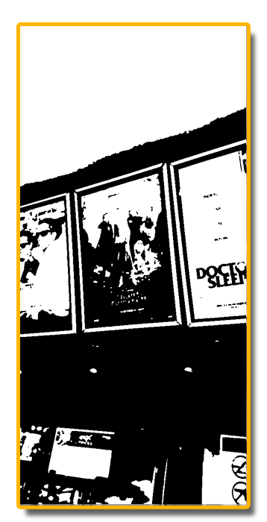
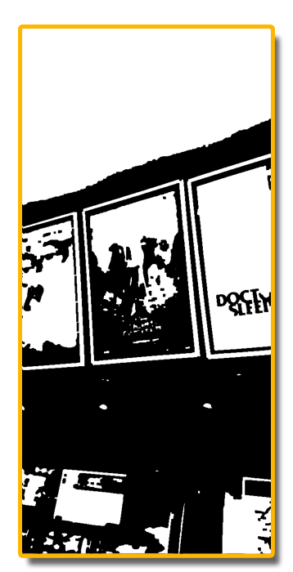
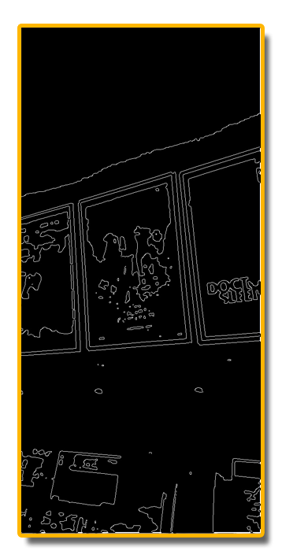
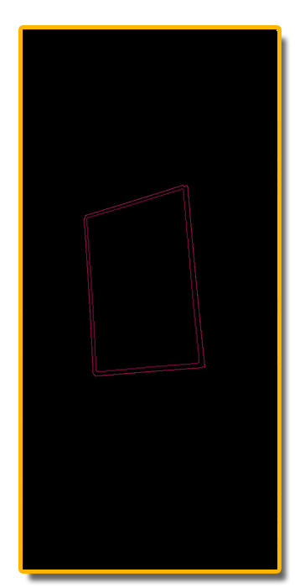
Approach - Poster Extraction Pipeline
Notes:
The extraction pipeline looks something like this,
First, we receive the original photo taken by the user
Then, we convert the image to grayscale, to make it easier to analyze and manipulate
Next, we apply a gaussian blur to the image. This will help define better edges
Then, we can simplify the image by applying a thresholding operations, converting it to a black and white, or binary image
At this point, several morphological operations can be applied in order to define better shapes. In this case, a closing operation suffices, filling small holes and linking interrupted edges.
Now Canny Edge Detection can be performed. The Canny algorithm extracts the defining edges of the image, and defines the contours of the objects being represented
Since all posters have a rectangular shape, we can now analyze the contours and check which ones have 4 corners and 4 sides.
Several contours may have these characteristics but, since the focus of the picture should be the poster itself, we can assume that it will be the largest rectangular contour.
Now that we have our poster contour and its defining corners, a 4 point perspective transformation can be applied.
Which will provide the final result

Slide 10

Approach - Poster Recognition
Compare the extracted poster to a collection of movie posters.
Split posters into regions
Compute their histograms
Histogram equalization
Compare histograms using various methods resulting in similarity metrics
Return the best match
Notes:
Having the extracted poster, we can now compare it to the existing movie posters
The comparison consists of:
Splitting the posters into several regions
Computing their histograms and equalizing them
And using several comparison methods
we will return the best match

Slide 11

Approach - Fetching Reviews
Library: BeautifulSoup
Language: Python
Approach:
fetch the review source’s web page
parse the HTML tree
find the review containers and extract the needed data: rating, review title, review text
Notes:
The second module of the project is the review fetcher
This was achieved by using the BeautifulSoup Python library
The overall process of consists of fetching the webpage in which the movie reviews are
Parsing the HTML tree using the methods provided by BeautifulSoup
And finding the review containers and extracting the data we need, such as: the rating, the title and the review itself.

Slide 12

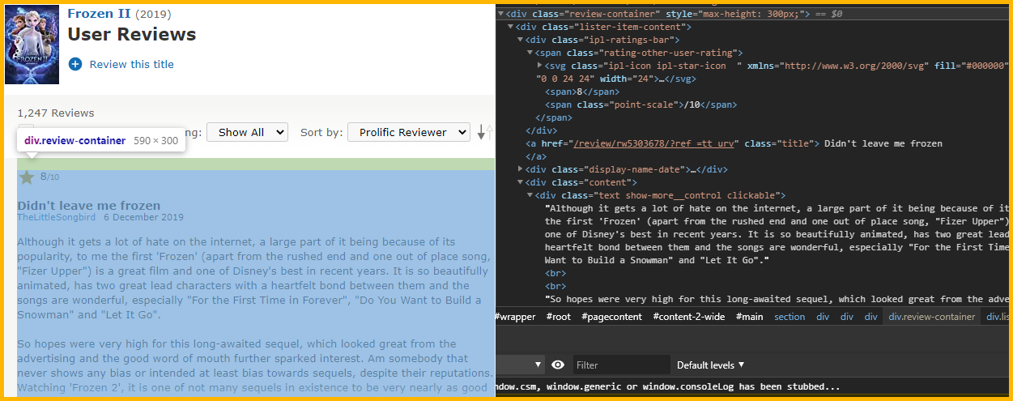
Approach - Analyzing the HTML page
Notes:
This technique is called web scraping
When web scraping, most of the time is spent in the browser, using its developer tools to analyze the page’s HTML structure
On the left we can see how a review looks in the web site and on the right is the HTML hierarchy that is used to build it

Slide 13

Approach - Using Existing APIs
OMDb API - functionalities used:
search function
movie information: title, poster, plot, director, etc.
TMDb API - functionalities used:
today’s popular movies
getting similar movies -> recommendations
Notes:
Since there are over 500 thousand movies, creating a database from scratch wasn’t an option.
Thus, I decided to use existing APIs
Firstly, the OMDb API was the primary one I used for searching movies and retrieving information such as titles, posters, directors and so on
Secondly, the TMDb API was used to retrieve the day’s popular movies and movie recommendations

Slide 14
Approach - Creating an Own API
Need a way to expose the poster recognition and review scraping functionalities
Framework: Django
Language: Python
Approach:
Have one endpoint for each of the functionalities
Deploy it on Heroku
Notes:
Additionally, in order to expose the functionalities of the previous modules, I decided to create an own api
Using the Django Python Framework
The idea is to have an endpoint for each functionality
And deploy it on Heroku

Slide 15
Approach - Available Endpoints
reviews/<imdbID> - fetches reviews from available sources
receives: IMDb id corresponding to a movie
returns: JSON containing the movie’s reviews
imageSearch/ - detects and recognizes a poster contained in an photo
receives: photo encoded in base64
returns: title of the movie
Notes:
The endpoints available were
Reviews – which receives an movie id and returns a json containing the movie’s reviews
Image Search – which receives a base64 encoded image and detects, recognizes and returns the title of the movie

Slide 16
Approach - Available Endpoints
popular/ - gets today’s popular movies through the TMDb API
returns: JSON containing the popular movies
recommended/<imdbID> - returns recommended movies similar to the given movie
receives: IMDb id corresponding to a movie
returns: JSON containing the recommended movies in a specific format
Notes:
Popular which simply returns a JSON containing the day’s popular movies by calling the TMDb API
And finally, recommended, which receives a movie’s id and returns a json containing similar movies

Slide 17

Approach - Mobile Application
Platform: Android
Language: Kotlin
Objective: Design and develop an Android app that:
Allows users to log in using third party systems
Makes HTTP requests in order to search for movies, retrieve information about them, gather reviews and provide recommendations
Provides a clean and intuitive user interface
Notes:
Finally, the mobile application
As it is the most popular mobile operating system, the application will be an Android app written in Kotlin.
Its objective is to allow users to authenticate using third party platforms,
Make http requests to the previously mentioned APIs to search for movies, view details about them, read their reviews and receive recommendations
all represented in a clean and intuitive user interface

Slide 18

Approach - Kotlin
Preferred programming language for Android app development - Google, May 2019
Features:
Null Safety
Type Inference
Properties
Coroutines
Notes:
I chose Kotlin because, as of 2019, Google announced it as the preferred programming language for Android development
some of the features that differentiate it from java are
Null Safety
Type Inference
Properties
And coroutines

Slide 19

Approach - Firebase
Google’s development platform that helps build, improve and grow applications.
Firebase Authentication
service that authenticate users
supports social login providers (Google, Facebook)
provides a user management system
Notes:
Firebase is Google’s development platform, which provides tools to improve applications
The main tool we are interested in is Firebase Authentication
It provides a way for users to authenticate using an existing Google account.
This directly ties into the theme of convenience, removing the need of creating an additional account for the app.

Slide 20

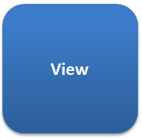
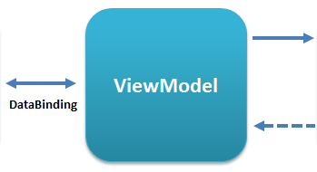
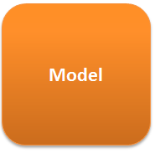
Approach - Android App Architecture
MVVM - Model-View-ViewModel
Notes:
In order to build a good, organized application, we had to choose an architectural pattern to follow while developing the Android application
I chose MVVM or Mode-View-ViewModel pattern
It facilitates the separation of graphical interface from the business logic such that they can be developed independently.
It has three components:
The Model – which simply holds the application data
The View – which represents what the user actually sees and how it is displayed on the screen
And the ViewModel, which links the two previous components. The ViewModel binds its properties to the view and sends updates so that the view is updated accordingly. This binding works both ways. Thus, it can be said that the ViewModel contains the state of the data in the Model.

Slide 21
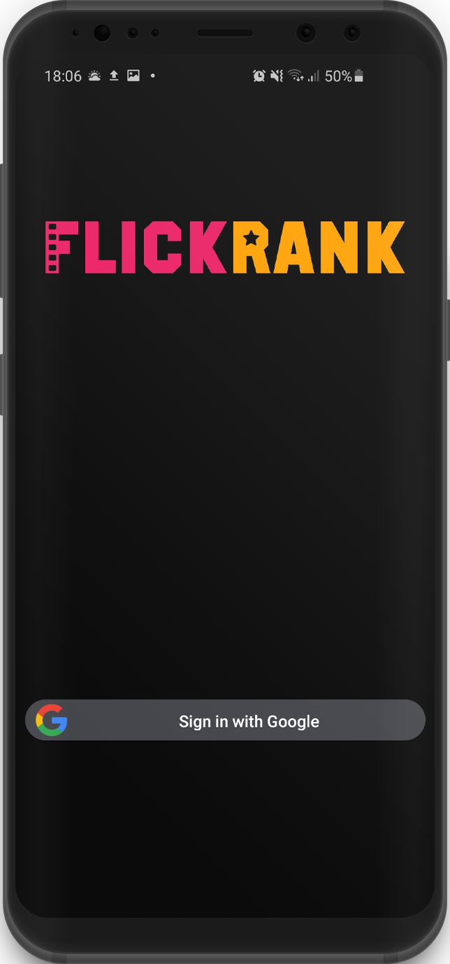
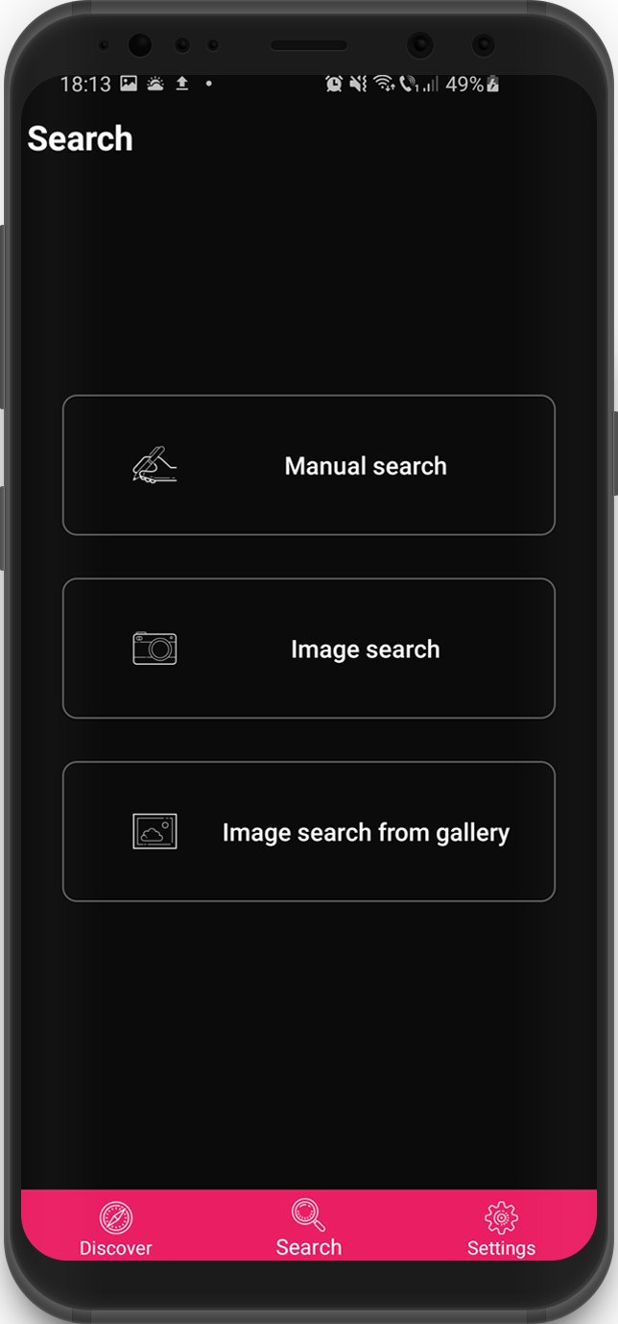
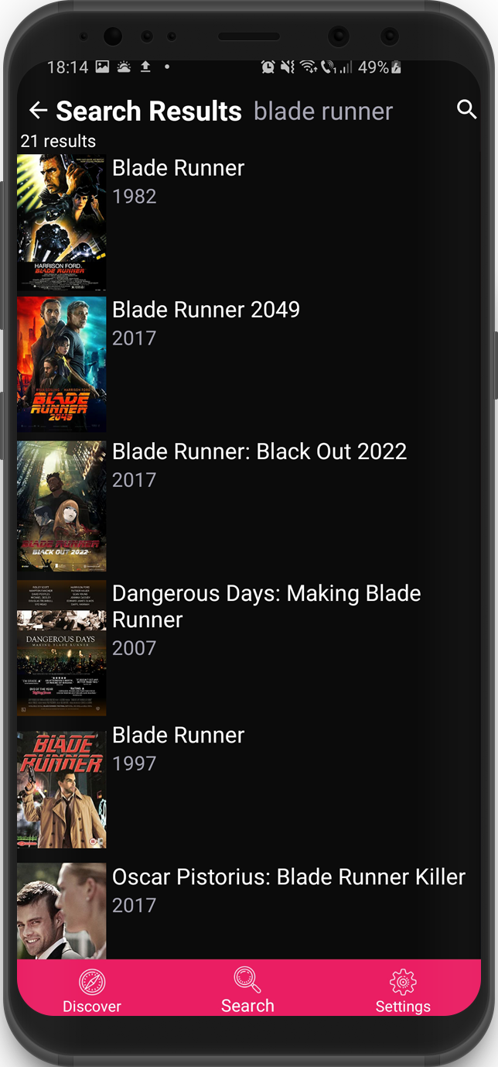
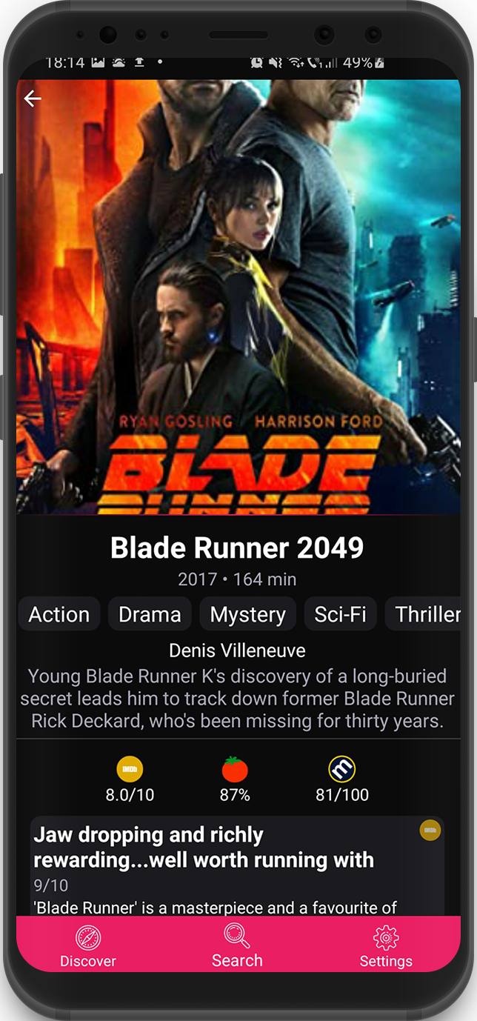
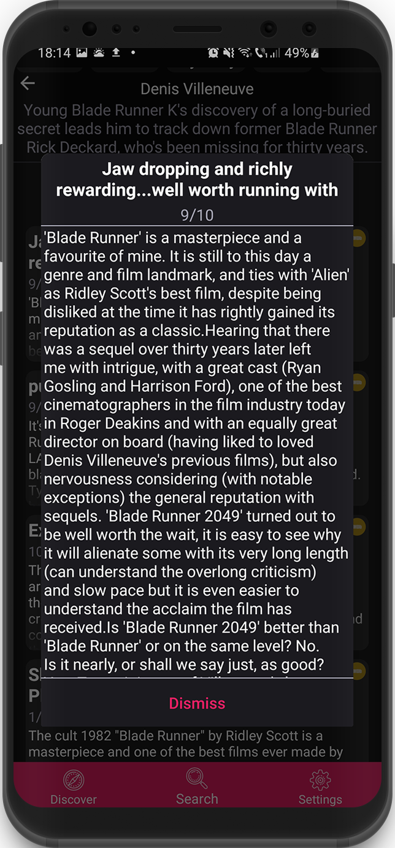
Finished Product
Notes:
Login page
Search page
Search results page
Movie page
Review

Slide 22

Student: Paul Tudor LINCA
Supervisor: Assist. Prof. Dr. Eng. Ion GIOSAN

